Slide 1
Ensemble Learning

Slide 2
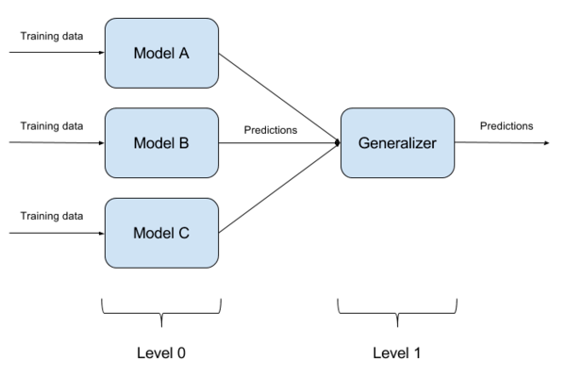
What is Ensemble Learning?
Use of multiple learning algorithms to obtain better predictive performance
Ensemble Techniques
Stacking
Multiple levels of models
Level-0 models are called base models
Higher level models are called meta models
Diverse models
K-fold cross validation is used for fitting base models
Predictions for out-of-fold samples of base models are used as input to the meta models
Blending
Similar to stacking
A part of training set is reserved as validation set
Predictions for validation set of base models are used as input to the meta models

Slide 3
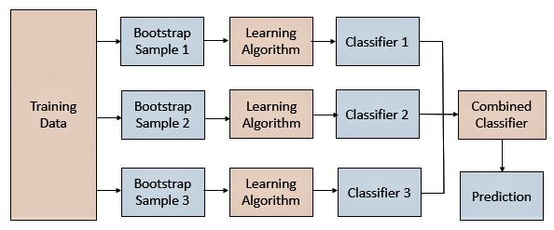
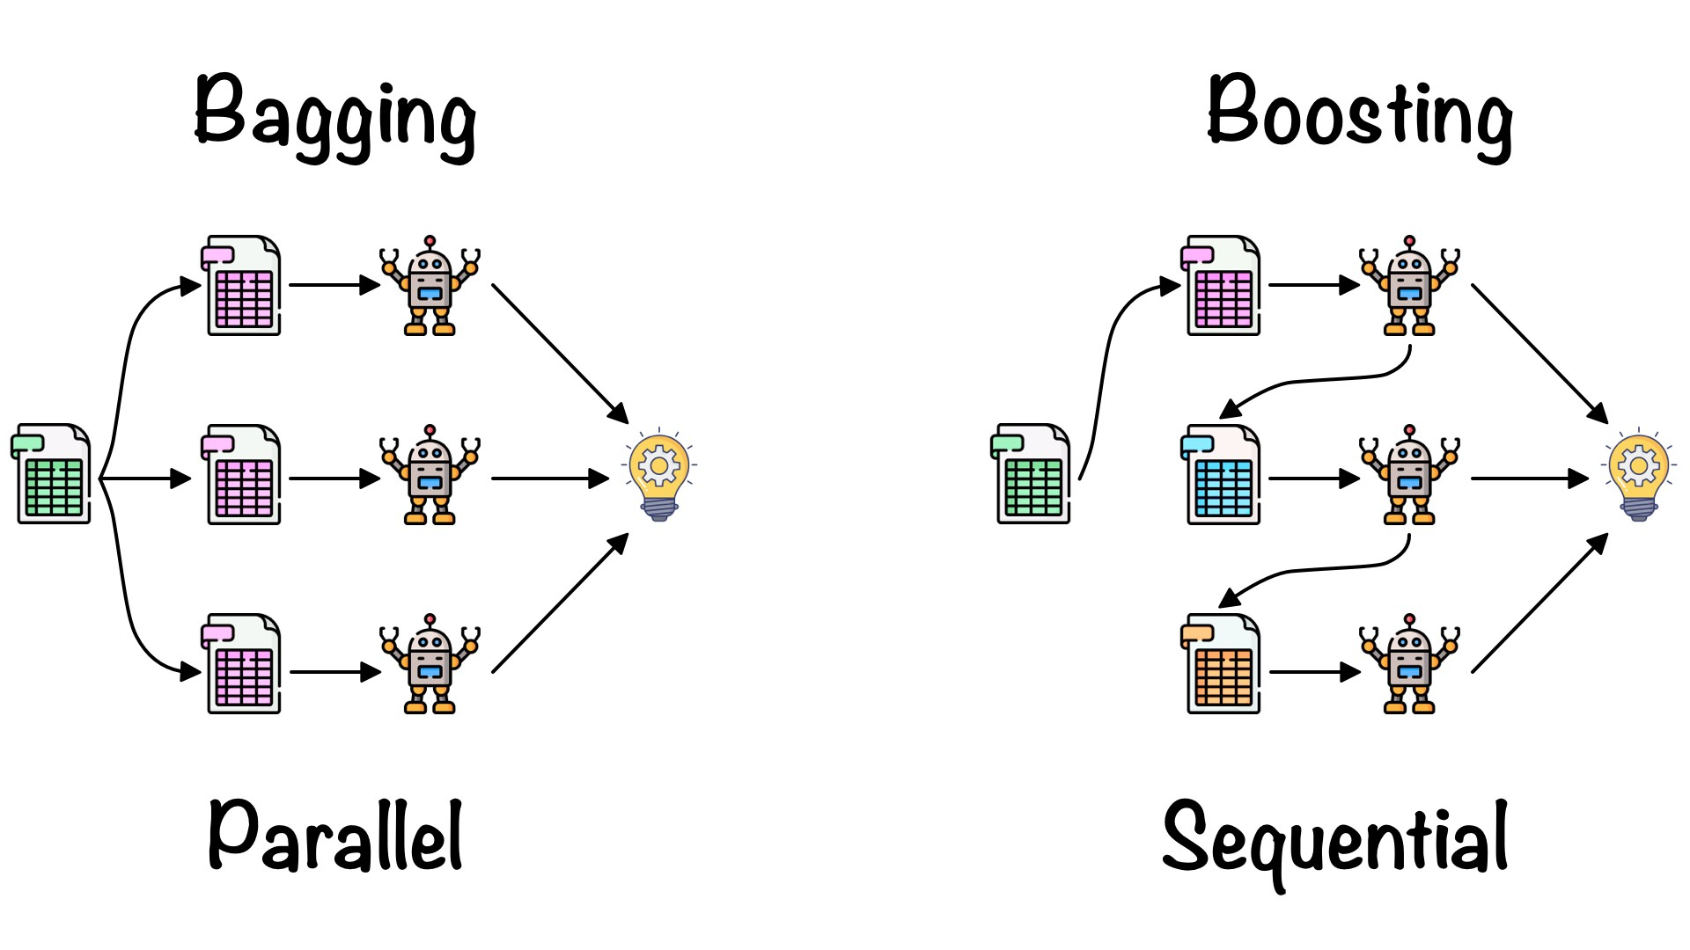
Bagging
Parallel ensemble method
Bootstrap Aggregating
Mainly used to reduce variance
Bootstrapping is used
Multiple models of the same type
Predictions are combined
Equal weightage to all the models
Boosting
Sequential ensemble method
Mainly used to reduce bias
Each subsequent model attempts to correct errors of the previous model
Misclassified samples given higher weights
Final prediction is weighted predictions from all the models (weak models)

Slide 4
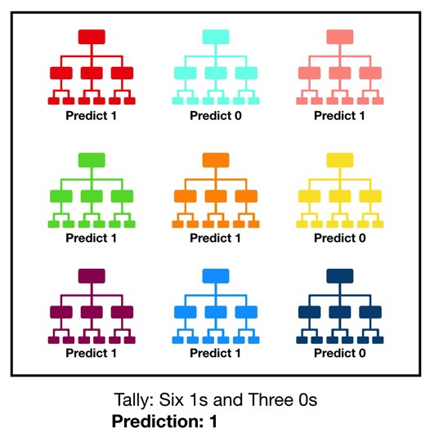
Random Forest (RF)
An ensemble ML algorithm based on Bagging technique
The models used are Decision Trees
Can be used for classification or regression
Each DT is fitted on a bootstrapped training set
Reduces overfitting and variance
For regression:
Final prediction is average of predictions
For classification:
Final prediction is the majority vote
Subset feature selection for uncorrelated trees
Hyperparameters:
Number of features
Depth of the trees
Number of trees

Slide 5
AdaBoost
AdaBoost is used to boost the performance of decision trees on binary classification problems
Uses decision stumps
Each training instance is assigned a weight which is initialized as
W_{i} = 1/N
When a decision stump is added, its misclassification error is calculated as
error = sum(W_{i}*t_{i})/sum(W_{i})
Where t_{i} is prediction error which is either 1 or 0
A stage value is used to weight the predictions from a decision stump, it is given as
stage = ln((1-error)/error)
Weight of each training instance is updated after adding a decision stump as
W_{i} = W_{i} * exp (stage * t_{i})
Each time a training instance is misclassified by a decision stump, its weight is increased

Slide 6
Hyperparameters
Number of estimators
Learning rate
Used to control the weight of contribution of each decision stump
Default value is 1
stage = learning_rate * ln((1-error)/error)
Depth of decision tree
Base learners
Gradient Boosting
Generalization of AdaBoost in terms of loss function
Uses a well-defined loss function and its Gradient to minimize it
Initial weak learners are small decision trees (may be decision stumps)
Each new decision tree, with multiple levels, is added to reduce the loss function using its Gradient

Slide 7
Hyperparameters
Number of trees
Number of samples to which each tree is fit
Number of features used to fit each tree
Learning rate
Depth of each tree
XGBoost
stands for eXtreme Gradient Boosting
An optimized version of Gradient Boosting Machine
L1 and L2 regularization to prevent overfitting
Can handle missing values (Sparsity aware)
Optimal split points
Built-in cross validation
CatBoost
Supports categorical attributes

Slide 8
Thank You

